Slide 1
17th May, 2019 Single-Cell Omics
Computational practical of Strand-seq Part 1:
From fastq to chromosome overview plot
¹David Porubsky, ²Hyobin Jeong
¹Dichler Lab, Department of Genome Sciences, University of Wachington
²Korbel Group, Genome Biology, EMBL
Notes:
Hello everyone, welcome to the practical session of the Strand-seq analysis. We will start the practical session from fastq to chromosome overview plot.

Slide 2
Which data do we analyze today?
RPE (Retinal pigment epithelial) cell lines will be analyzed
RPE-1 is commonly used to study patterns of SV and genomic instability
C7 was generated via gamma-irradiation of RPE cells followed by selection on soft agar as an indicator for cellular transformation (Riches et al. 2001)
BM510 was generated via silencing the mitotic spindle machinery and constructing an anchorage-independently growing cell line, which is likely to exhibit a variety of SV classes.
RPE1-WT
Practical
Wednesday
RPE1-C7
RPE1-BM510
Notes:
Today we will going to analyze Strand-seq data from RPE cell line which is retinal pigment epithelial cell lines. RPE-1 wild type is commonly used to study patterns of SV and genomic instability. C7 was generated via gamma-irradiation of RPE cells followed by selection on soft agar as an indicator for cellular transformation. BM510 was generated via silencing the mitotic spindle machinery and constructing an anchorage-independently growing cell line, which is likely to exhibit a variety of SV classes. Among them RPE1-C7 was used for the wet lab practical on last Wednesday. Therefore today we are gonna focussing on C7 and compare it with the BM510 data.

Slide 3
Processing the Strand-seq library after sequencing
Input: Paired-end fastq files : *_1_sequence.txt.gz *_2_sequence.txt.gz
Step1. Align reads, mark duplicates, add read groups
bwa mem -t {threads} \ -R '@RG\tID:{params.name}\tSM:{SAMPLE_NAME}\tLB:{wildcards.cell}' \ {params.genome} \ {input} \ | samtools view -bT {params.genome} - \ > {output}
bammarkduplicates markthreads={threads} I={input} O={output} index=1 rmdup=0
Step2. Filter & count bins in fixed windows
Rscript {params.qc_plot} {input.counts} {input.info} {output}
Step3. Plots and statistics
Rscript {params.sv_plot} {input} plot_chromosomes/{SAMPLE_NAME}/window_{wildcards.window}
Don’t worry, we can do it with one touch using Snakemake!
Notes:
This is the overview of the preprocessing of the Strand-seq library after sequencing. We will get fastq files as a format of paired-end sequence.txt files. We will align reads, mark duplicates, add read groups using those commands. And then we will filter and count binds in fixed windows using R script. Finally we will plots and make statistics using another R script. This looks like long story, but we can do it with workmanagement tools Snakemake.

Slide 4
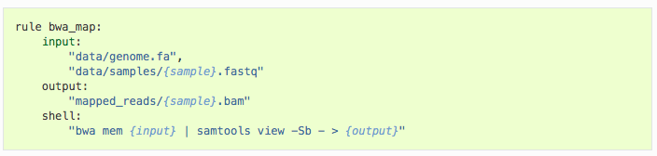
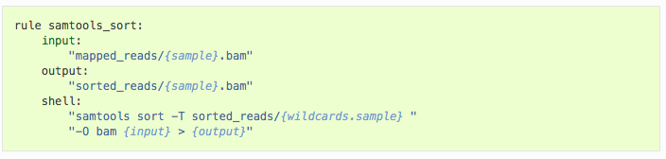
Workflow management with Snakemake
Snakemake is a Python-based workflow management tool
It can run workflows consisting of multiple inter-dependent tasks. These can be computed either locally or on the cluster.
Intermediate results are stored, so the pipeline only executes what is left to do.
See http://snakemake.readthedocs.io or https://bitbucket.org/snakemake/snakemake/overview
Notes:
Snakemake is a python-based workflow management tool. It can run workflows consisting of multiple inter-dependent tasks. These can be computed either locally or on the cluster. Intermediate results are stored, so the pipeline only executes what is left to do.

Slide 5

Step1: Download and install the pipeline
Original script was developed by Sascha Meiers: https://git.embl.de/meiers/strand-seq-pipeline
It’s stored in an in-house git code repository https://git.embl.de/
git clone https://github.com/jeongdo801/Strand_seq_practical_computational.git Practical_C7
cd Practical_C7
tar -xvzf practical.tar.gz
cd practical
less Snakefile
Notes:
This Snakemake pipeline for the Strand-seq analysis was originally developed by Sascha, who was the PhD student in Korbel lab. We will clone this first from the github and then start the processing.

Slide 6
Step2: Add sequencing data to the pipeline
Tell the pipeline which data to use by copying/linking files into a fastq subdirectory
Strand-seq raw data is stored here:
/g/korbel/shared/data/others/StrandSeq
Strand-seq analysis data is typically stored on
/g/korbel2/StrandSeq
We will start with 10 cells from RPE-1 C7
mkdir fastq
cd fastq
wget -O H2KT2AFXY_C7x02_18s002199-1-1_Raeder_lane1C7x02PE20301_1_sequence.txt.gz https://www.dropbox.com/s/kayg7n0l7mm88wq/H2KT2AFXY_C7x02_18s002199-1-1_Raeder_lane1C7x02PE20301_1_sequence.txt.gz?dl=0
wget -O H2KT2AFXY_C7x02_18s002199-1-1_Raeder_lane1C7x02PE20301_2_sequence.txt.gz https://www.dropbox.com/s/pit8jt3858z5ug2/H2KT2AFXY_C7x02_18s002199-1-1_Raeder_lane1C7x02PE20301_2_sequence.txt.gz?dl=0
...
Notes:
Single-Cell RNA-Seq Reveals AML Hierarchies Relevant to Disease Progression and Immunity

Slide 7
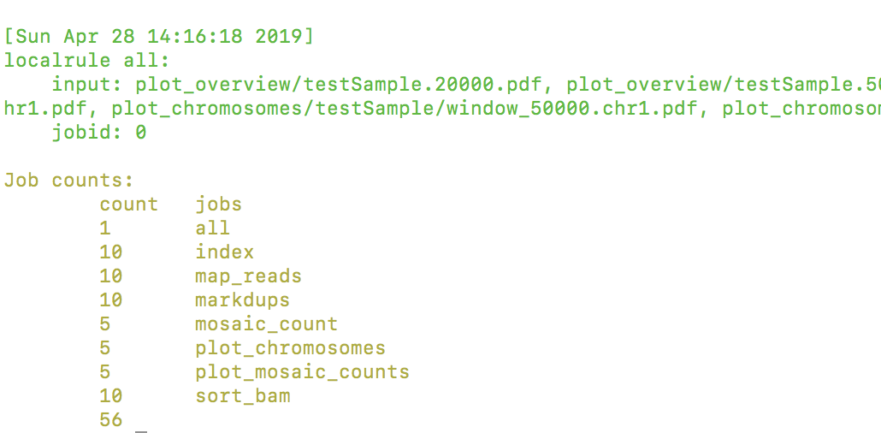
Step3: Set the sample and execute the pipeline
Edit the Snakemake file to specify the sample name and potentially other variables.
Using snakemake -n you can see which jobs are going to be computed. Run snakemake locally or on the cluster.
cd ../
vi Snakefile
#Change the sample name testSample into C7_data
#Save with :wq
snakemake -n
snakemake -j 4 # Compute locally using 4 cores
Notes:
Single-Cell RNA-Seq Reveals AML Hierarchies Relevant to Disease Progression and Immunity

Slide 8
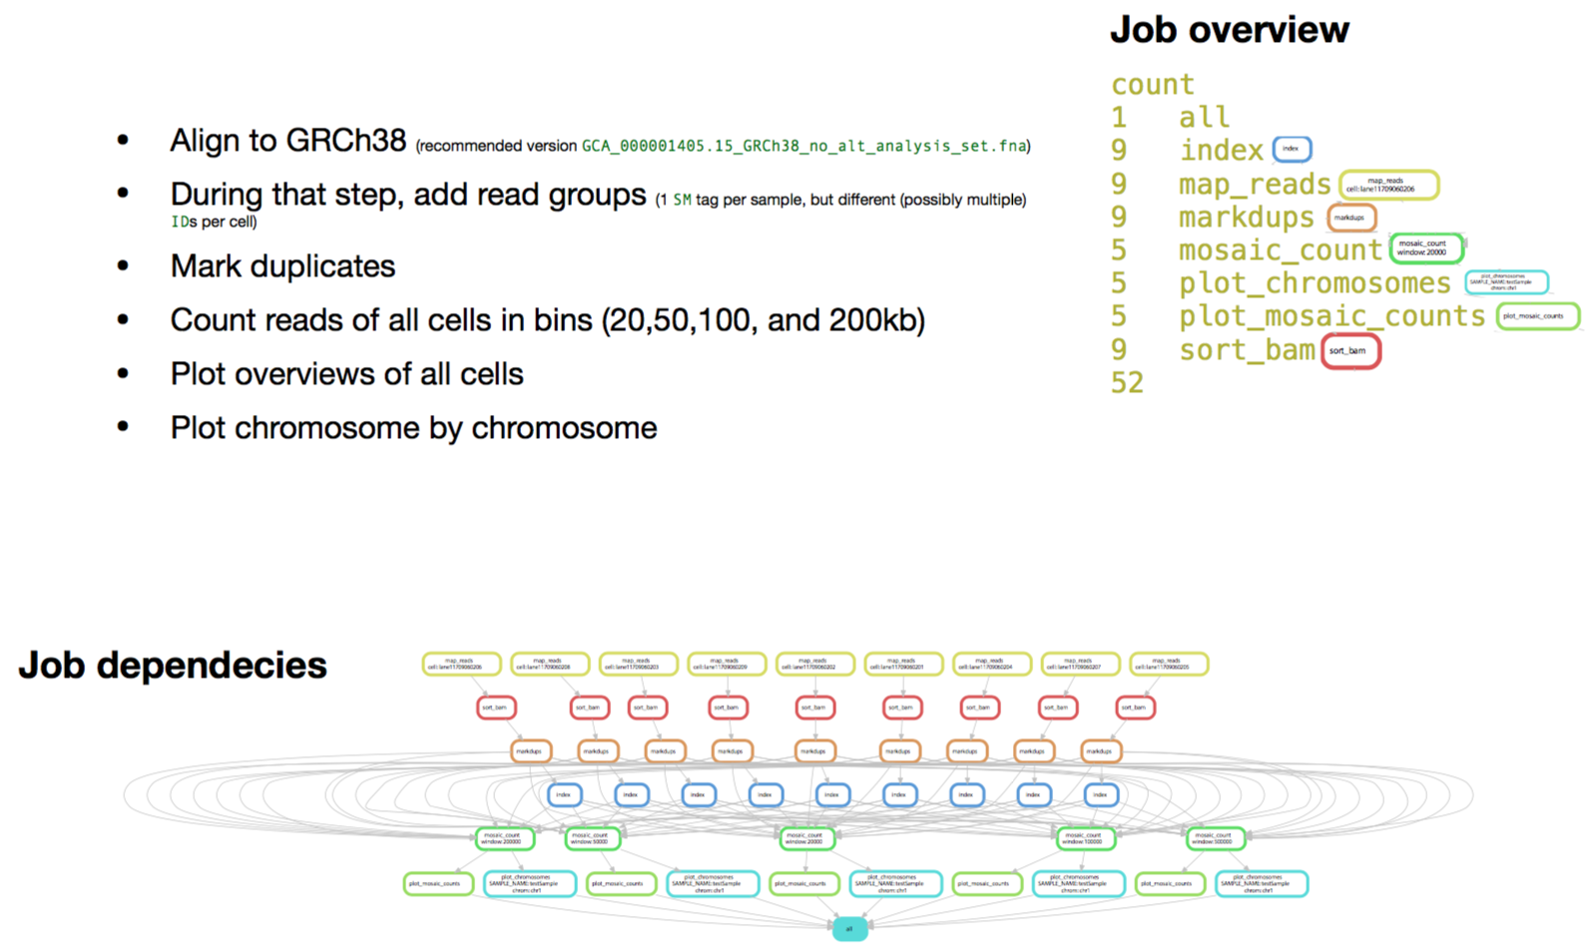
What will be happened in the pipeline?

Slide 9
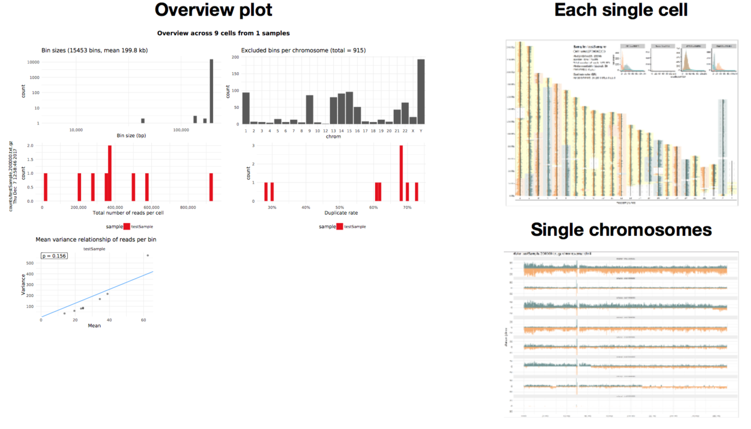
Output of the pipeline
Three different plots for quality checking and first look for the SVs
Bam files from this pipeline will be used as an input of downstream advanced analysis

Slide 10
Challenges
After finishing the pipeline (~1h), let’s explore the overview plot of C7. What are the clonal SVs and what are the SCEs of the C7?
Compare the RPE-1 C7 and BM510 overview plot, which SVs are in common, and which SVs are specific to BM510 or C7?
RPE1-WT
RPE1-C7
RPE1-BM510
#You can explore the processing result of BM510 as follows:
https://github.com/jeongdo801/Strand_seq_practical_computational/BM510.500000.pdf

